Slide 1
Engineering design 2026
Lecture Week 3
Deck 1
Project Scope and Groups
Prof Henri Marais
29 Jul 2026

Slide 2
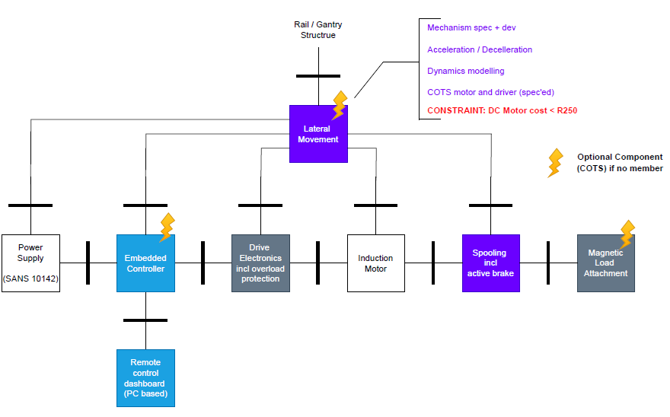
Initial Scope of work

Slide 3

Group allocation
Ideally
Actual
Class divisible by 6
Equal fractions of EEII/REII/MCTR327 students
Class divisible by 6 but
Max 2x < > / group >>> not enough REII students

Slide 4
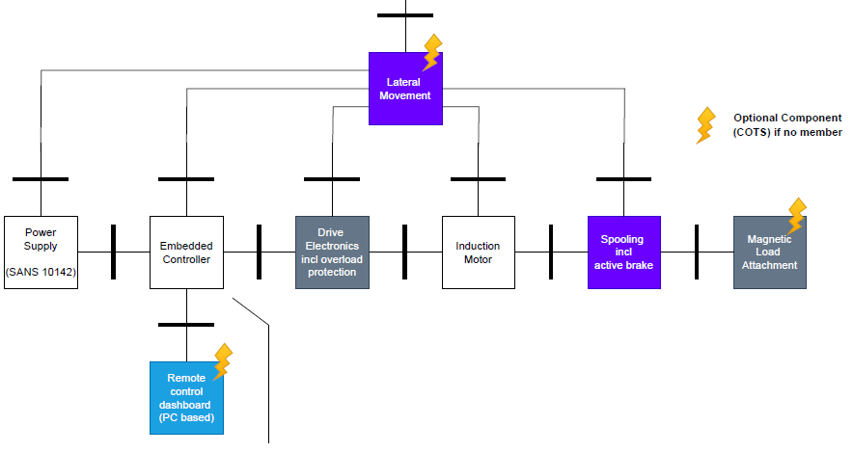
Reworked scope of work

Slide 5
Scope of work and constraints

Slide 6
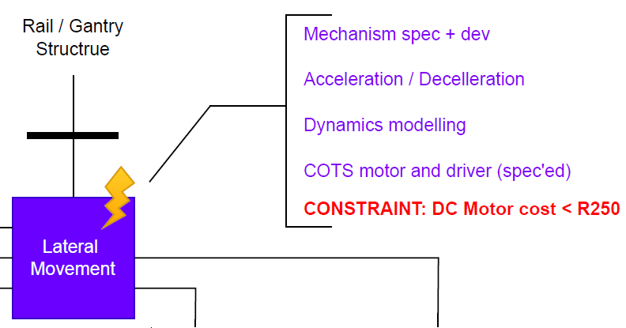
MCTR 1 – Lateral movement

Slide 7
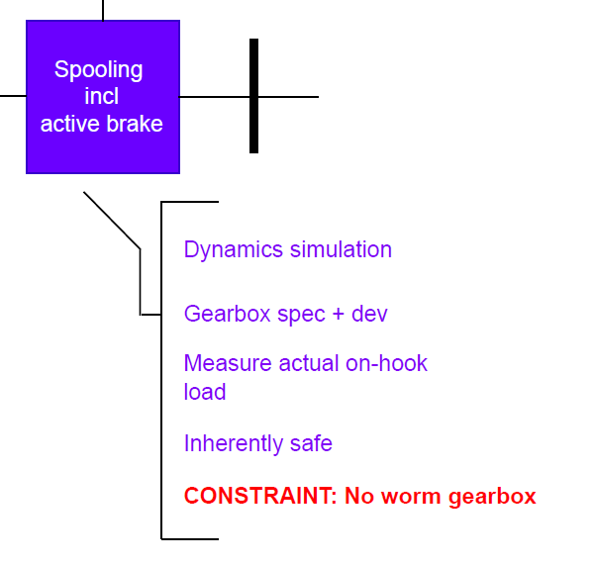
MCTR II – SPOOLING

Slide 8
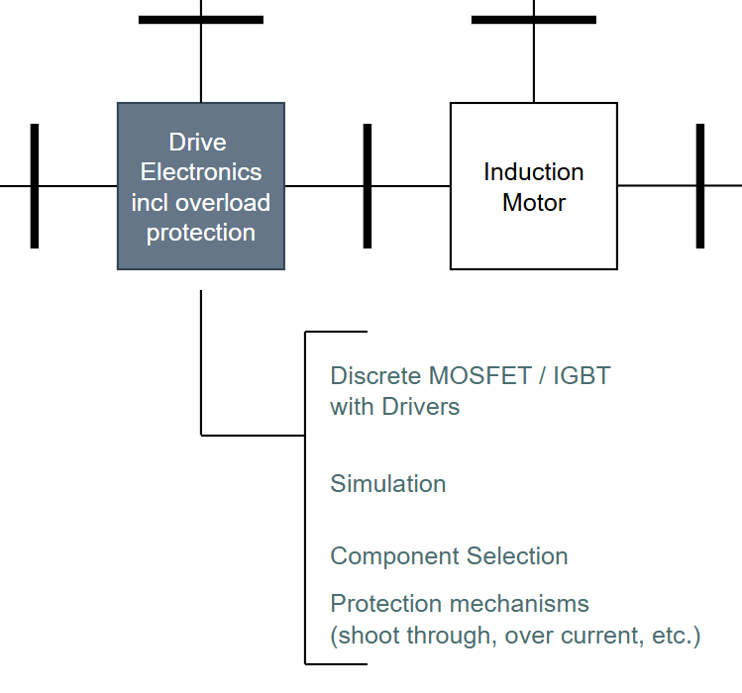
EEII I – Drive Electronics

Slide 9
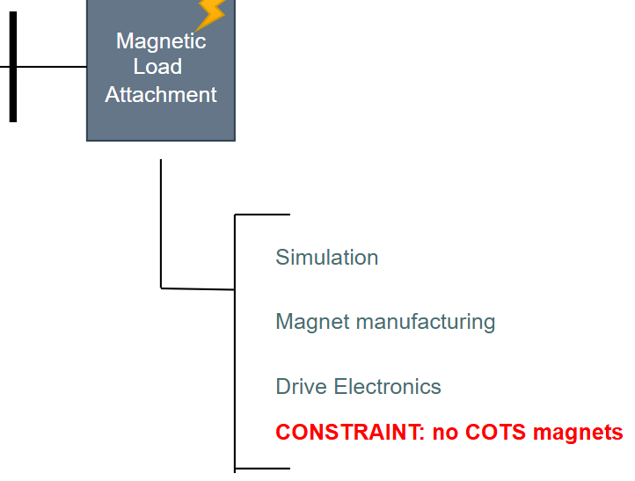
EEII II – MAGNETIC LOAD ATTACHMENT

Slide 10
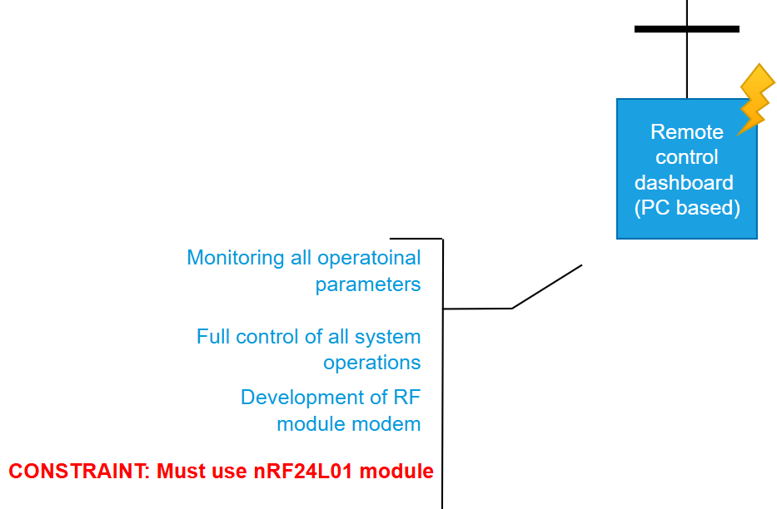
REII – REMOTE CONTROL DASHBOARD

Slide 11
Summary
Group sizes reduced (6 down to 5)
Some groups are under-staffed (scope of work reduced)
In under-staffed groups work package selection degrees of freedom may be reduced
No group members may move between groups

